Slide 1


Beyond Generation after Next military concept development
​
ISMOR 42
Guy Griffiths, Becky Evans, Chloe Ainger
This document has been prepared solely for ISMOR 42
and may not, without permission, be disclosed to any third party.
Author/s: Griffiths, Evans, Ainger
© Sagentia Defence 2025

Slide 2
The best way to predict
the future is to invent it.
Alan Kay

Slide 3

Workshop session purpose
Beyond Generation after Next military concept development ​
The aim of this interactive workshop is to generate future military concepts based on a selection of low-TRL Science and Technology (S&T) ideas.
Drawing on the knowledge and experience of attendees, the session will identify potential applications for each idea and develop relevant concepts and use cases.
Each will then be assessed for timeliness, relevance, unfamiliarity and exploitability via a simple assessment exercise.
The workshop will mirror the process used by Alchemy.
Alchemy is a consortium of companies led by Sagentia Defence that is delivering game-changing future S&T concepts to Dstl.

Slide 4
Session agenda
Introduction
20 mins ​
Explanation of Alchemy and the Dstl Futures Engine Room
What makes a good Concept?
Breakout group instructions
Breakout groups concept development x 3
30 mins ​
Choosing a signal
Discussing a viable concept
Populating the template
Generating RAG scores
Concept brief backs x 3
30 mins ​
Participant / facilitator explanation
Group Q and A / discussion ​
Session summary
10 mins ​
Would these concepts survive the pipeline?

Slide 5





Alchemy and the Engine Room
What is Alchemy?
  Alchemy is a consortium of companies led by Sagentia Defence which aims to:
Support Dstl to investigate emerging S&T signals to create advantage for and de-risk the future of Defence
What is Defence Science & Technology Futures (DSTF)?
  DSTF sits within DSTL with the aim to better prepare Defence for the future by exploring promising novel technologies and concepts.
  DSTF examines how novel science, technologies and concepts may be used and combined to generate future capabilities; the issues and challenges they could precipitate; and the S&T investments and policies needed to fully exploit them.

Slide 6
Alchemy / DSTF concept pipeline process
Gate 1
Gate 2
Gate 3
Signal Generation
Harvesting of signals from across the international research landscape.
Concept Definition
Creatively explore signals to understand how we might exploit new and emerging S&T.
Concept Development
Use a range of tools and techniques to evaluate a concept in the context of multiple possible futures.
Concept Maturation
Refine our scientific understanding and write research questions that can be experimentally tested to de-risk the concept.
Concept Assessment
Commission research /analysis to increase the TRL and lower the risk to facilitate onwards exploitation
Transition / Exploitation
Passing ownership of the concept to a relevant programme for onwards maturation and exploitation.

Slide 7


What makes a good Defence Futures Concept?
Generation after next – or beyond
Grounded in science
Potentially transformative for one or more areas of defence
Revolutionary vs evolutionary
A path to exploitation
Doesn’t need to be ‘right’ (at this stage..)

Slide 8
TRUE score RAG levels
Timeliness Score | Relevance Score
The extent to which 'now' is the best time to investigate the idea. | The extent to which the idea could be applied within Defence in the future.
Red – Evidence that 'now' is not the best time to act (‘watching brief’) Amber – Evidence that more research is needed before deciding whether to act. Green – Evidence that 'now' is the best time to act. | Red – Has the potential to impact at least one military function / domain. Amber – Has the potential to impact several military functions / domains. Green – Has the potential to change the way Defence operates across multiple functions / domains .
Unfamiliarity Score | Exploitation Score
The extent to which the idea is believed to be unknown, particularly to Defence. | The extent to which a potential innovation pathway(s) can be imagined/identified.
Red – MOD has not explored. Amber – UK science enterprise has not explored. Green – International science enterprise has not explored other than to minimal extent. | Red – Initial scientific idea. Amber – Idea validated through science (with possible application areas of technology concepts documented). Green – Technology validated/operationalised in the real world

Slide 9
The Three Whys
Why Futures?
Is the concept new, disruptive and (beyond) generation after next?
Why Defence?
Is there an advantage to Defence developing this?
Why Now?
What are the consequences if Defence does not pursue this?

Slide 10
Example Concept Card: Biologically Imitating Robot Doves (BIRD)
Is this concept a threat, opportunity, or both? Both
Why Defence?
Covert intelligence gathering is crucial for defence, no other industry will progress this type of masked UAV.
Which parts of Defence could use it, or need to react to it?
ISTAR
Why S&T Futures?
This concept details a GAN design of UAVs, for defence-related purposes.
What is needed to exploit it?
R&D to perfect the articulation of drone mechanics, to have increased range and speed compared to a typical UAV.
Masking of noise generated in a current UAV, fully mimicking behaviours/visual/acoustic signatures.
Consideration of environment and weather.
Why now?
Drone advancements are progressing very rapidly, and the prevalence of drone warfare is increasing.
TRUES SCORES | Impact/consideration
Factor | Score | Confidence | Justification
Timeliness | Amber | M | A successful application of this concept is GAN, and it opens doors for other covert sensing to mimic biological organisms.
Relevance | Amber | M | This application of covert UAV sensing is very relevant to defence and would have great impact on growing drone warfare.
Unfamiliarity | Amber | L | Unknown if other organisations/countries are exploring this, it is likely they are.
Exploitability | Amber | M | UAV capabilities are currently established, but R&D required to perfect the bio-mimicking to the degree it needs to be successful in this concept.
Scale of effort | M | M | Medium level of effort predicted, adapting existing UAV mechanics to fit this concept.

Slide 11
Example Concept Card: Biologically Imitating Robot Doves (BIRD)
Tagline
Mimicking and manoeuvring like a bird for concealing in plain sight.
Owners | xxx | Date Created | xxx
Technology taxonomy |  | Related signals | Dove-like flying
Identify the fundamental S&T | UAVs, sensing, projectiles
Summary
This concept involves a flock of UAVs moving organically like birds, to drop a payload or sense and observe. These BIRDs can be designed to appear like a variety of bird breeds, using their wing beat as propulsion and perching on trees/buildings. Use of this style of UAV could also be used underwater, mimicking movements of fish. This concept focuses on both detectability and adaptability, as for UAVs the weather and environment is a common issue to overcome in design.
What might we be able to do with this new S&T?
Covert sensing/detection.
Potential for underwater use, mimicking fish.
Designing the birds as projectiles, to fly into aircraft engines in-air.
Dropping a payload over a target.
What are the S&T insights that led to this concept?
The signal to this concept details the ability to mimic the behaviours of a bird, as a UAV. This includes the signature, appearance and generally blending in.

Slide 12
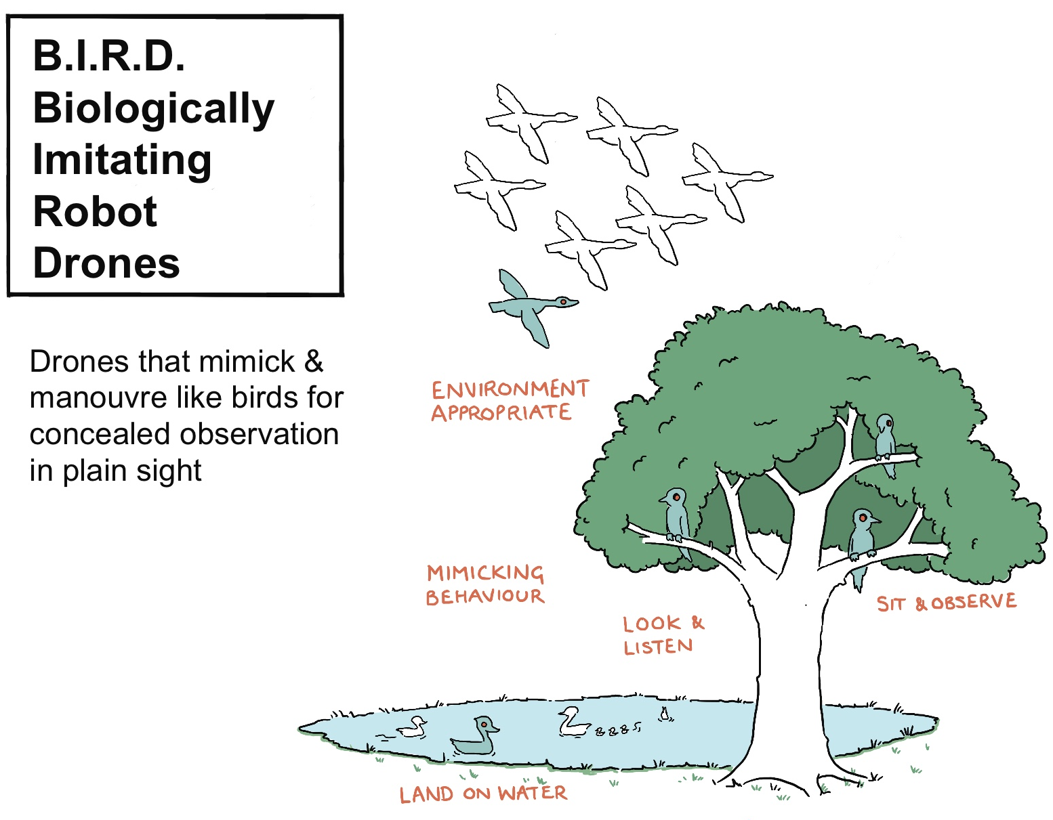
Example Concept Card: Biologically Imitating Robot Doves (BIRD)

Slide 13
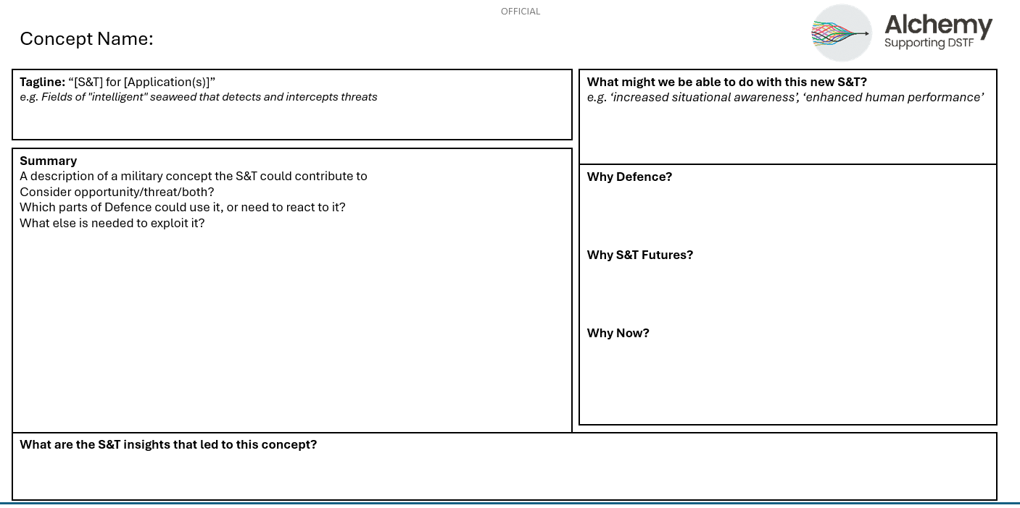
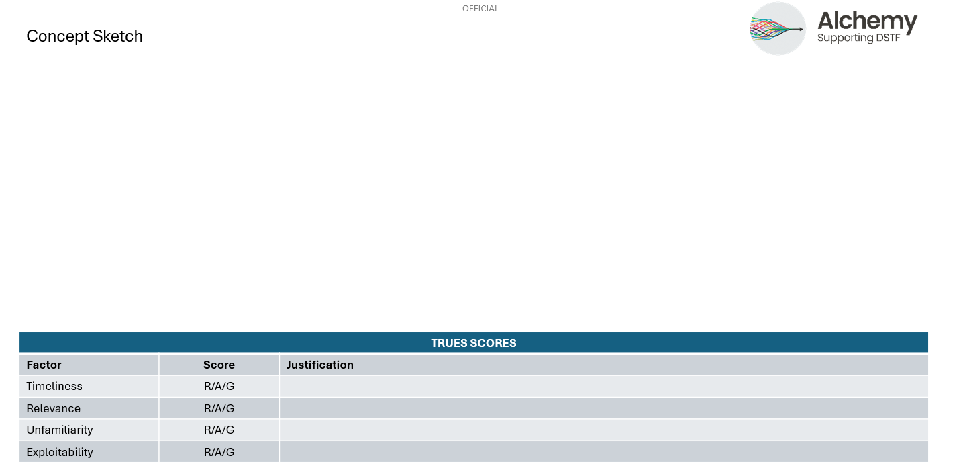
Breakout group instructions
  Each group will have a Sagentia Defence facilitator: their role is to explain the process and to steer development of a concept.
  Task 1: Choose a single signal to develop
  Task 2: Discuss the signal:
    What area of S&T does it relate to?
    How could this S&T be adopted in a military concept (a platform, an augmentation)
  Task 3: Complete the template, including an artist's impression!
  Task 4: Complete a rapid RAG assessment for each TRUE category

Slide 14

Concept brief backs
Ten minutes per group:
  Introduce the signal
  Explain the concept
  Explain the RAG scorings
  Brief discussion

Slide 15

Session summary
  Would these concepts progress through the actual pipeline?
  Participant feedback

Slide 17
Beyond Generation after Next military concept development
OR Society – ISMOR 42
Guy Griffiths, Becky Evans, Chloe Ainger
This document has been prepared solely for the OR Society
and may not, without permission, be disclosed to any third party.
Author/s: Griffiths, Evans, Ainger
© Sagentia Defence 2025

